Slide 1
EES203: Geochemistry
Instructor: Anoop Ambili
Email id: anoop@iisermohali.ac.in

Slide 2
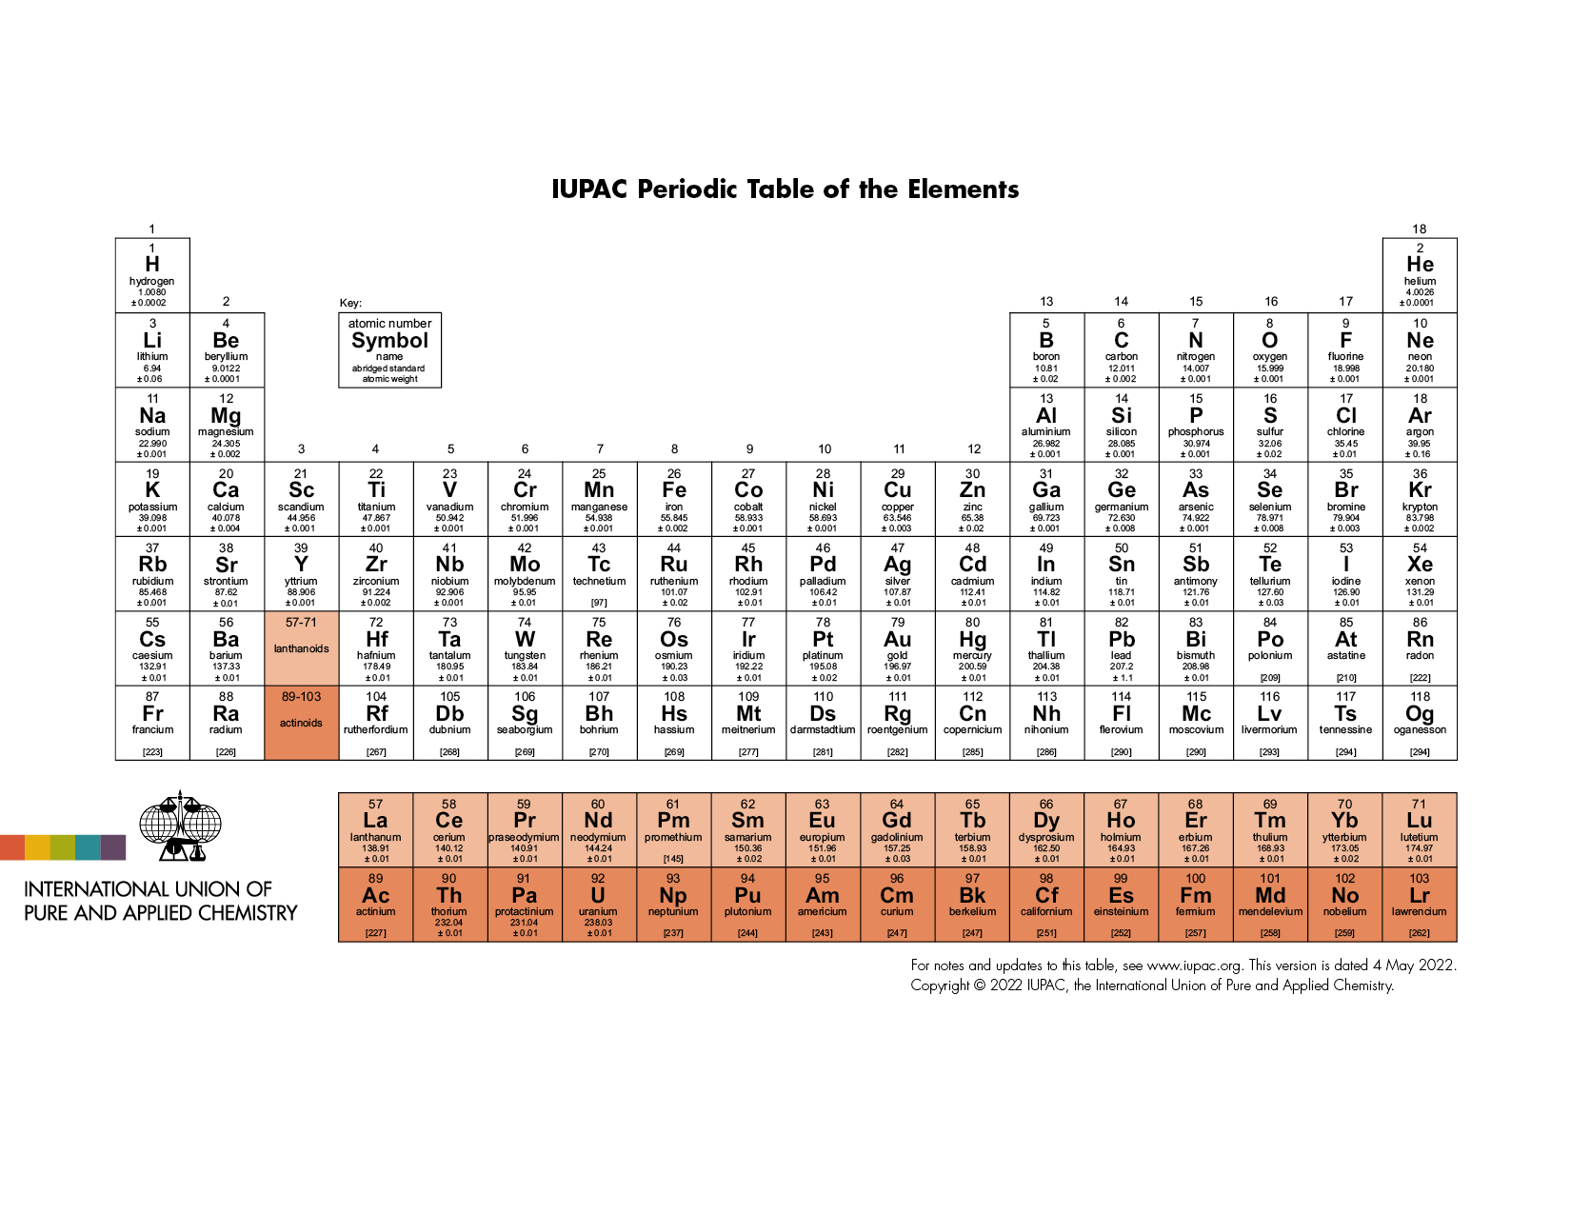

Slide 3
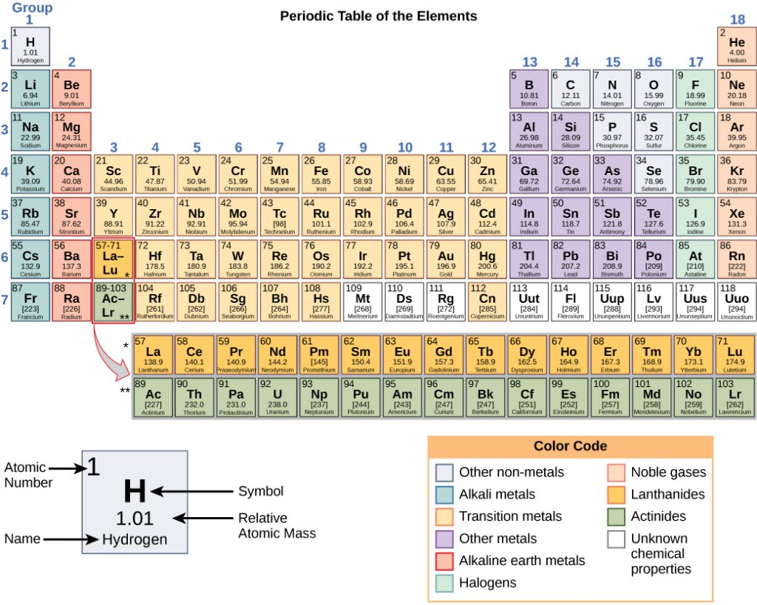

Slide 4
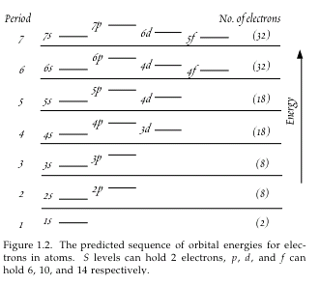
The Electronic Structure of Atoms
Electrons and Orbits
The electronic structure of an atom largely determines the chemical properties of the element.
Elements within the same group of the Periodic Table have the similar outer electronic configuration and behave chemically similar.
Each electron shell corresponds to a period or row in the Periodic Table.
The periodic nature of chemical properties reflects the filling of successive shells with additional electrons.

Slide 5
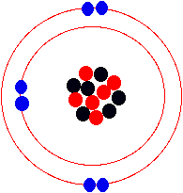
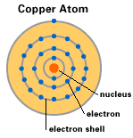
The Electronic Structure of Atoms
L shell
K shell
N
L
M
K
Electron shell representation of carbon atom:
The inner-most (first) shell is full as it can hold only two electrons. The second shell can hold eight but has only four.
Protons, neutrons, electrons
The copper atom has one lone electron in its outer shell, which can easily be pulled away from the atom.

Slide 6
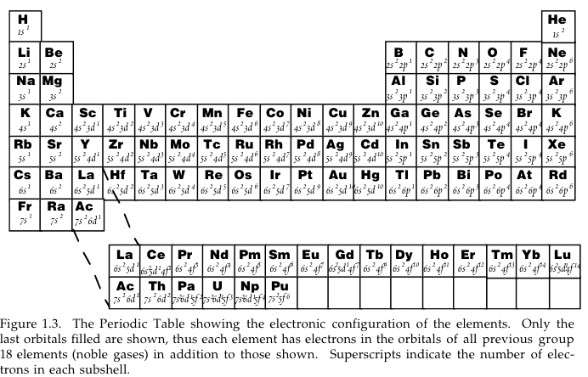
The Electronic Configuration of the Elements

Slide 7
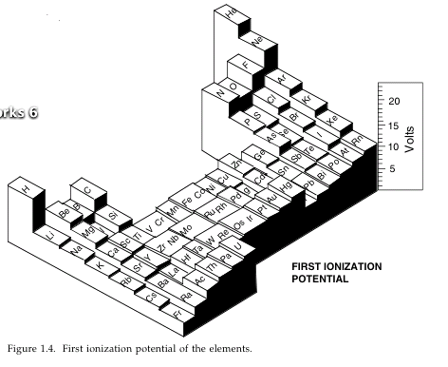
Chemical Properties of the Elements
Ionization potential
The First Ionization Potential is the energy required to remove the least tightly bound electron from the atom.
Example: H --> H⁺ + e⁻
The second, third, … ionization potentials are defined correspondingly.
Valence is the number of electrons given up or accepted. Transition metals often have more than one valence. Example: Fe(II) and Fe(III)

Slide 8
Chemical Properties of the Elements
Electron Affinity
Electron Affinity is a measure of the desire or ability of an atom to gain electrons. It is an energy concept. The formal definition states that Electron Affinity is the amount of energy released when an electron as added to an atom.
Most atoms tend to lose energy when they gain electrons. Some atoms do not. The elements located in the upper right corner of the periodic chart have the high E.A. values (usually found as anions), while those in the lower left corner have the low E.A. value (usually found as cations ). A generic equation of the EA process would be as follows.
X + e⁻ --> X⁻¹ + EA. Often this is measured in electronvolts.

Slide 9
Chemical Properties of the Elements
Electronegativity
The concept of Electronegativity refers to the ability of a bonded atom to pull electrons towards itself.
It is defined as the relative ability of an atom in a molecule to attract electrons towards itself. As atoms bond, electrons are shared or transferred. The atom with the higher electronegativity will dominate the electrons.
In order to be able to determine electronegativity values it is important to observe the behavior of atoms in a bonded situation. Consequently, the Noble Gases do not usually appear with listed electronegativity values.

Slide 10
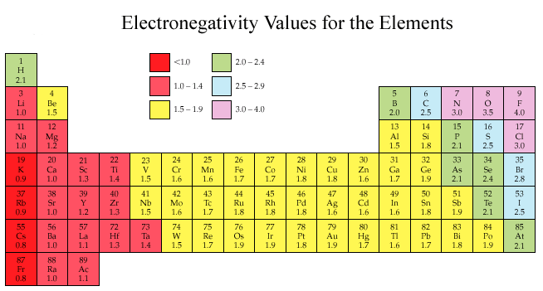
Chemical Properties of the Elements
Pauling Scale
The Pauling Scale is the most commonly used scale of electronegativity values. The scale is based on Fluorine having the largest electronegativity with a value of 4.0. The Francium atom is assigned the lowest electronegativity value at 0.7. All other values are located between these extremes.
Examples: Li--1.0 Be--1.5 B--2.0 C--2.5 N--3.0 O--3.5 F--4.0.
(Pauling scale)

Slide 11
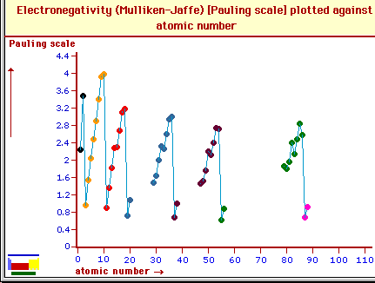
Chemical Properties of the Elements

Slide 12
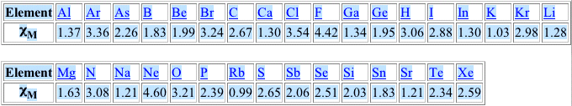
Chemical Properties of the Elements
R.S. Mulliken (1934) proposed an electronegativity scale in which the electronegativity, χ_{M} is related to the electron affinity EAv (a measure of the tendency of an atom to form a negative species) and the ionization potential IEv (a measure of the tendency of an atom to form a positive species) by the equation:
χ_{M} = (IEv + EAv)/2
The subscript v denotes a specific valence state.
The Mulliken electronegativities are expressed directly in energy units, usually electron volts.

Slide 13
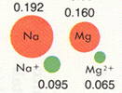
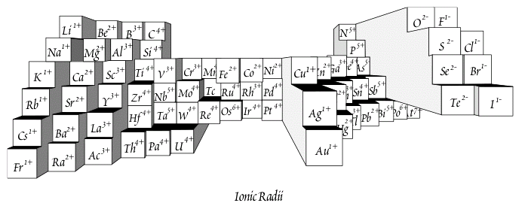


Chemical Properties of the Elements
Ionic radius
Cations have smaller radii than anions. Ionic radius decreases with increasing charge.
Ionic radius is important for geochemical reactions such as substitution in crystal lattices, solubility, and diffusion rates.
Comparison of some atomic and respective ionic radii (in nanometers)

Slide 14












Abundance of the Elements
The diagram below shows the relative abundance of the elements in the cosmos and in Earth’s crust.
10
9
8
7
6
5
4
3
2
1
0
-1
-2
H
He
Log atomic abundance per 10⁶ atoms of Si
C
O
Ne Mg Si _{S}
N
Ar
Ca
Cr
Ti
Fe
Ni
Na
Al P
Notable crustal depletion of non-gas elements relative to cosmic abundance
F
Cl
Zn
7
6
5
4
3
2
1
0
-1
-2
-3
Li
O
Si
V
Ge
Se
Kr Sr
Zr
B
Ca
Fe
Mo
Pd
Te Xe
Cosmic Abundance
Pb
H
K
Ga
Rb
Sn
Ba
La
Dy
Os
Hf
Pt
Mg
P
Ti
As
Nb
Sr _{Zr}
Ir
C
In
Sb
Eu
Re
Bi
S
Zn
Ba
Lu
N
Cr
_{Co} Cu
Br Y
Nd
Gd
Be
Sc
Ru _{Pd}
Sn
La
Er
Hf
(He)
Ge
Mo
Tl
Pb
Th
(Ne)
Crustal
W
U
Se
Abundance
Bi
(Ar) Ag In
0 5 10 15 20 25 30 35 40 45 50 55 60 65 70 75 80 85 90 95
(Kr) (Xe)
Au Hg
Z (atomic number)
Cosmic abundances are from Ahrens, L.H., 1965, Distribution of the Elements in our Planet: New York, McGraw-Hill, 110 p.; Crustal abundances are from Krauskopf, K.B., 1979, Introduction to Geochemistry (2nd edn.): New York, McGraw Hill, 617 p.

Slide 15
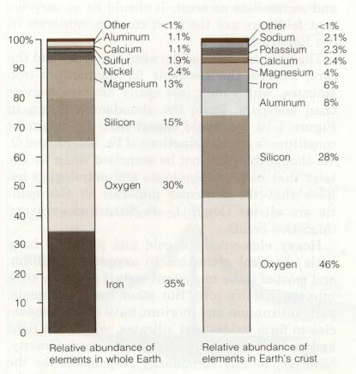

Slide 16
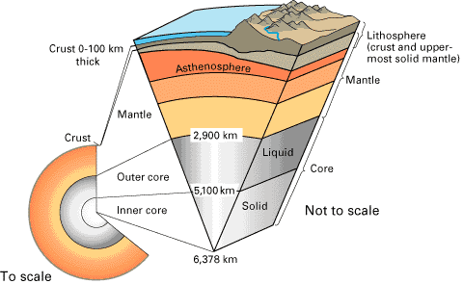
3 Major Zones, 2 Transitions
Earth’s Chemical Differentiation
CRUST
MOHO - ~40km
Wiechert-Gutenberg discontinuity
CORE

